Slide 1
Chapter 13 – Bioreactors: Enabling Technologies for Research and Manufacturing

Slide 2
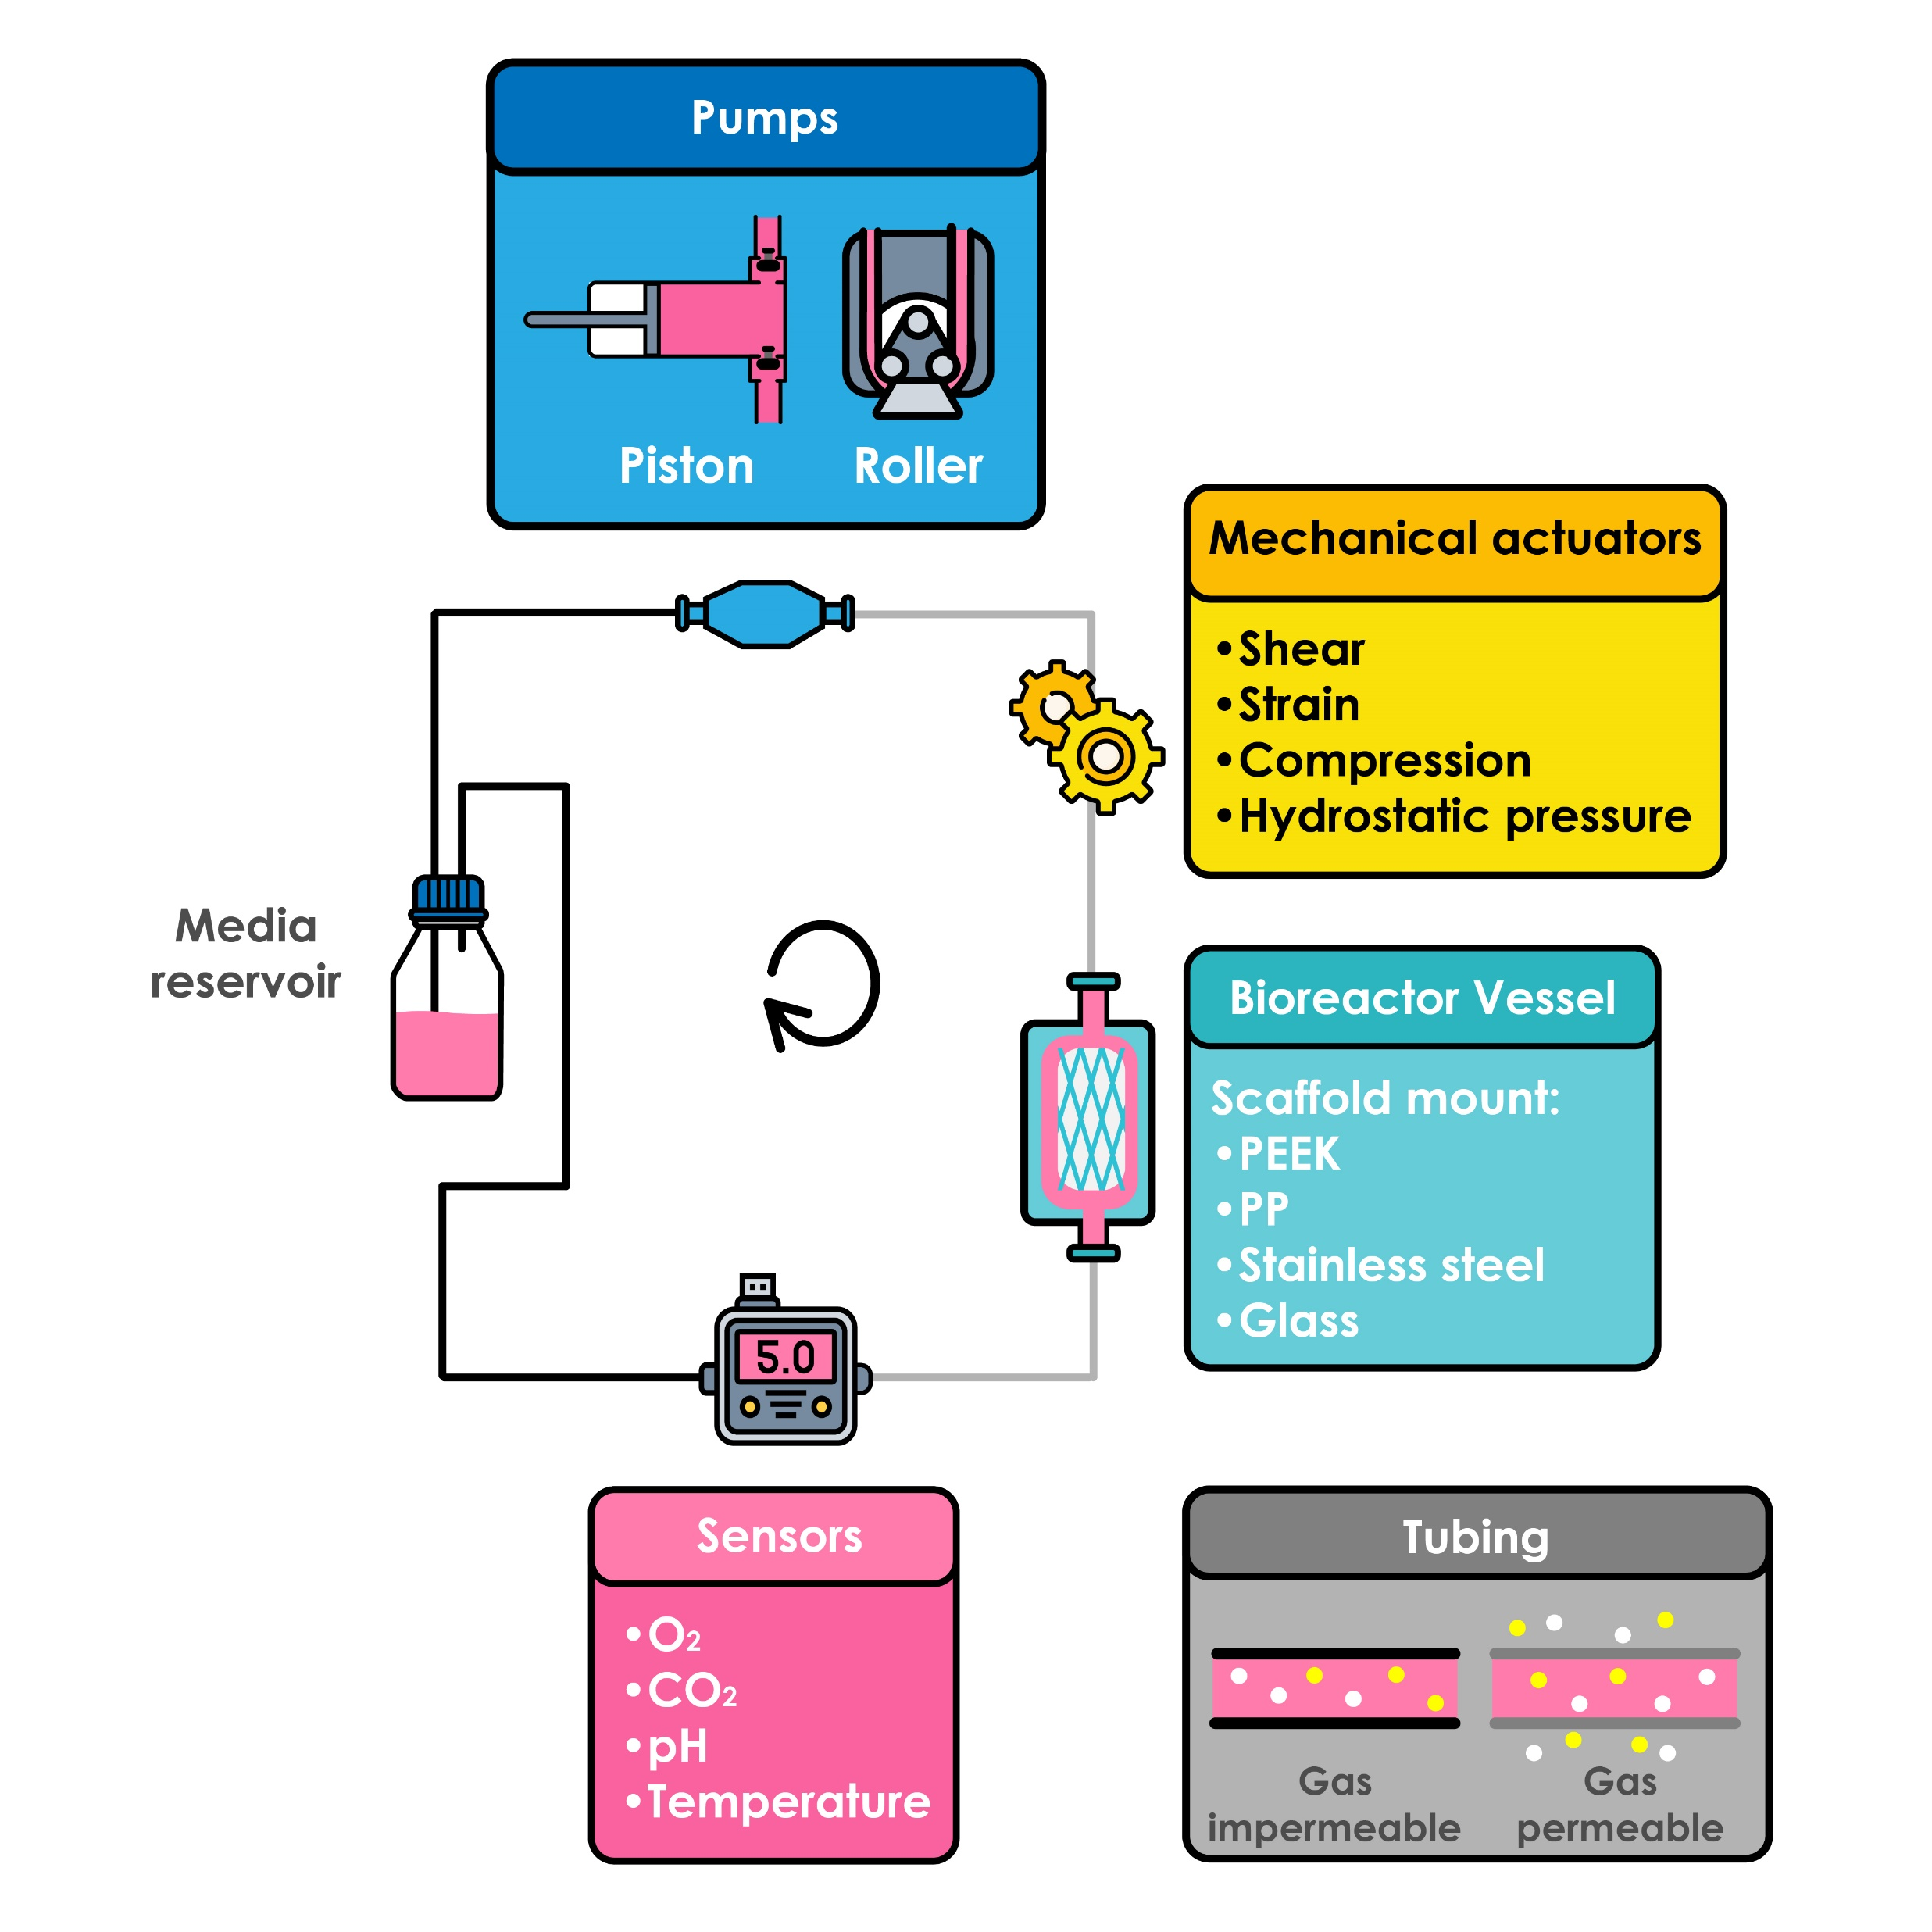
Notes:
Figure 13.1: Circular bioreactor set-up with basic bioreactor components.

Slide 3
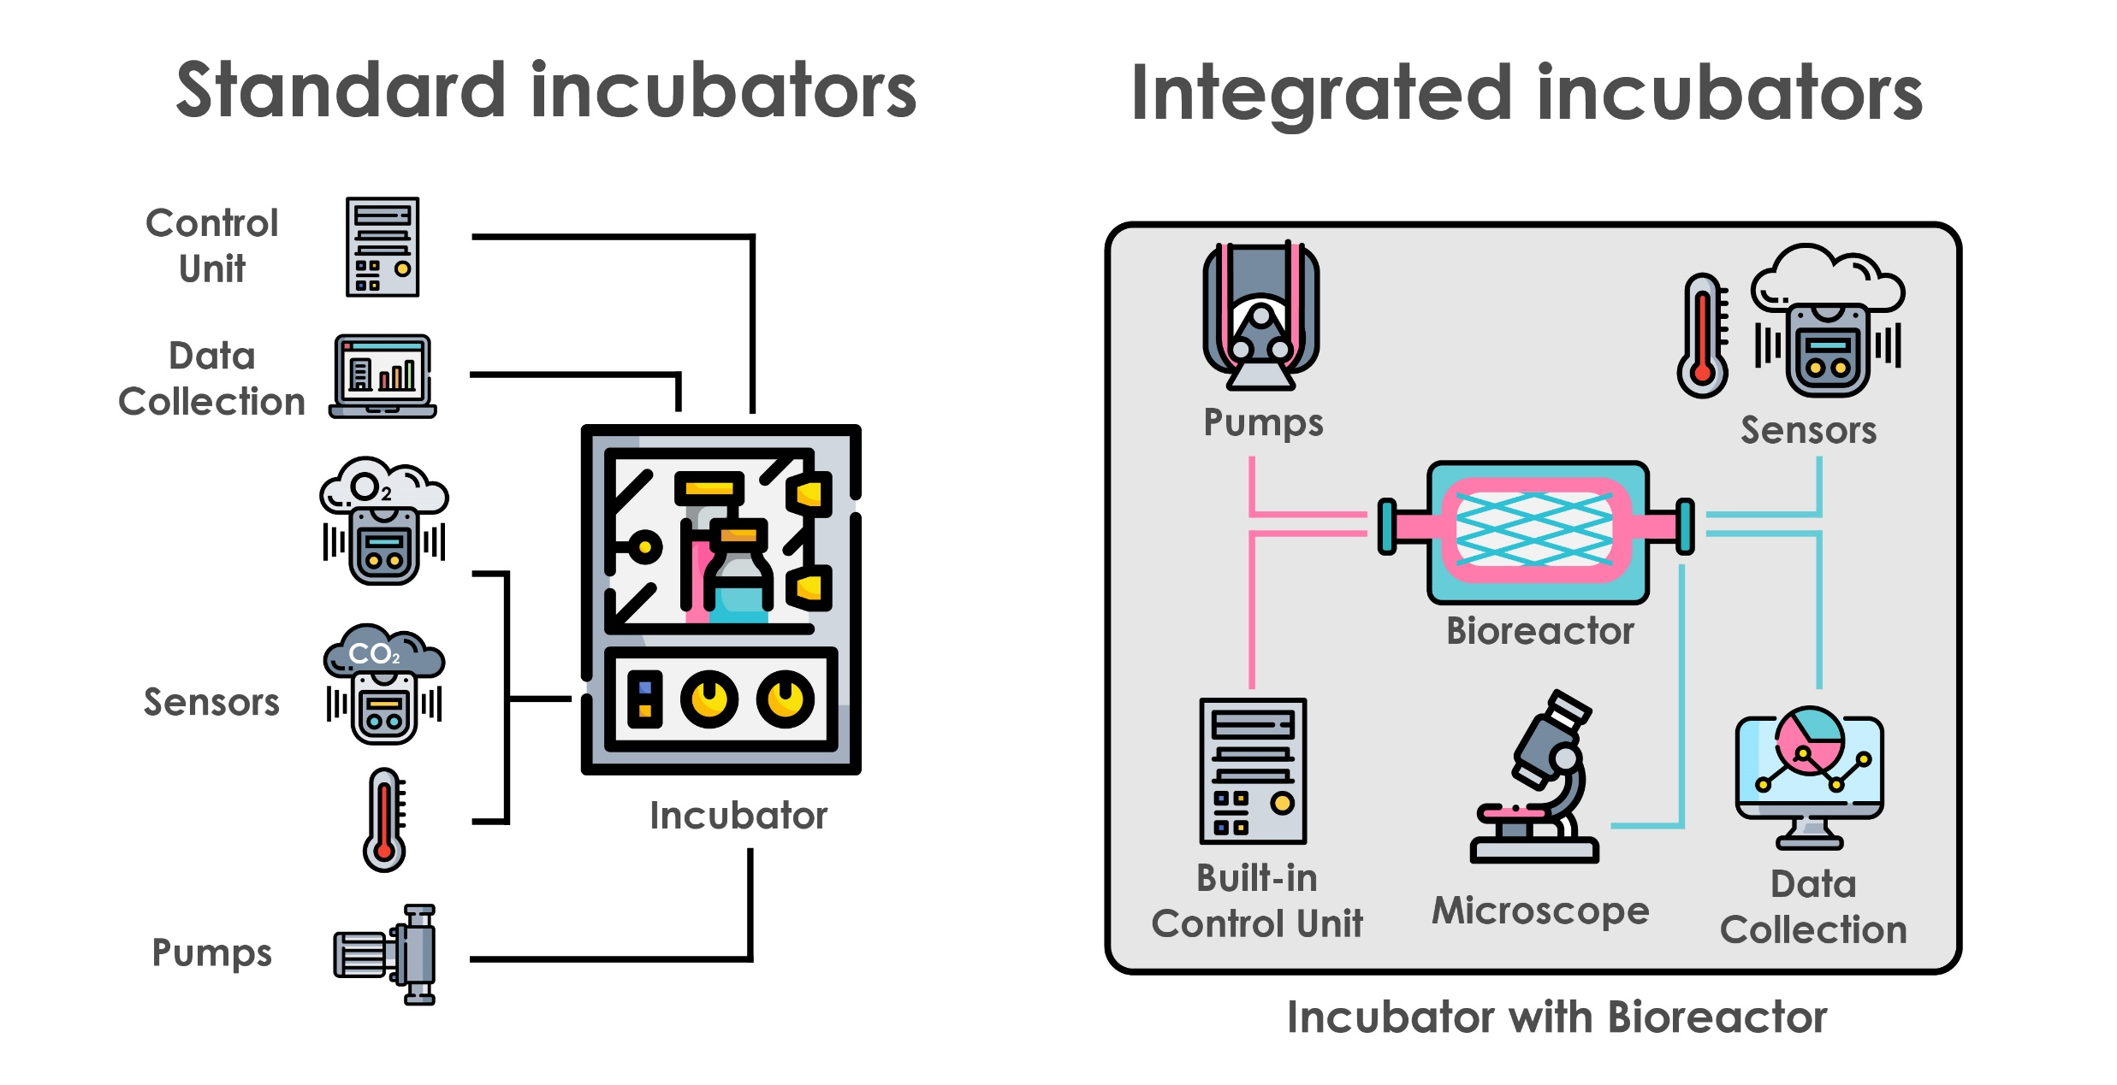
Notes:
Figure 13.2: Traditional standard incubators versus advanced integrated incubator systems.

Slide 4
Notes:
Figure 13.3: Concentration gradients of a growth factor within a simple in vitro setup (static) and in vivo.

Slide 5
Notes:
Figure 13.4: Selection of physical stimuli with impact to the tissue and tissue maturation within an in vitro bioreactor system.

Slide 6
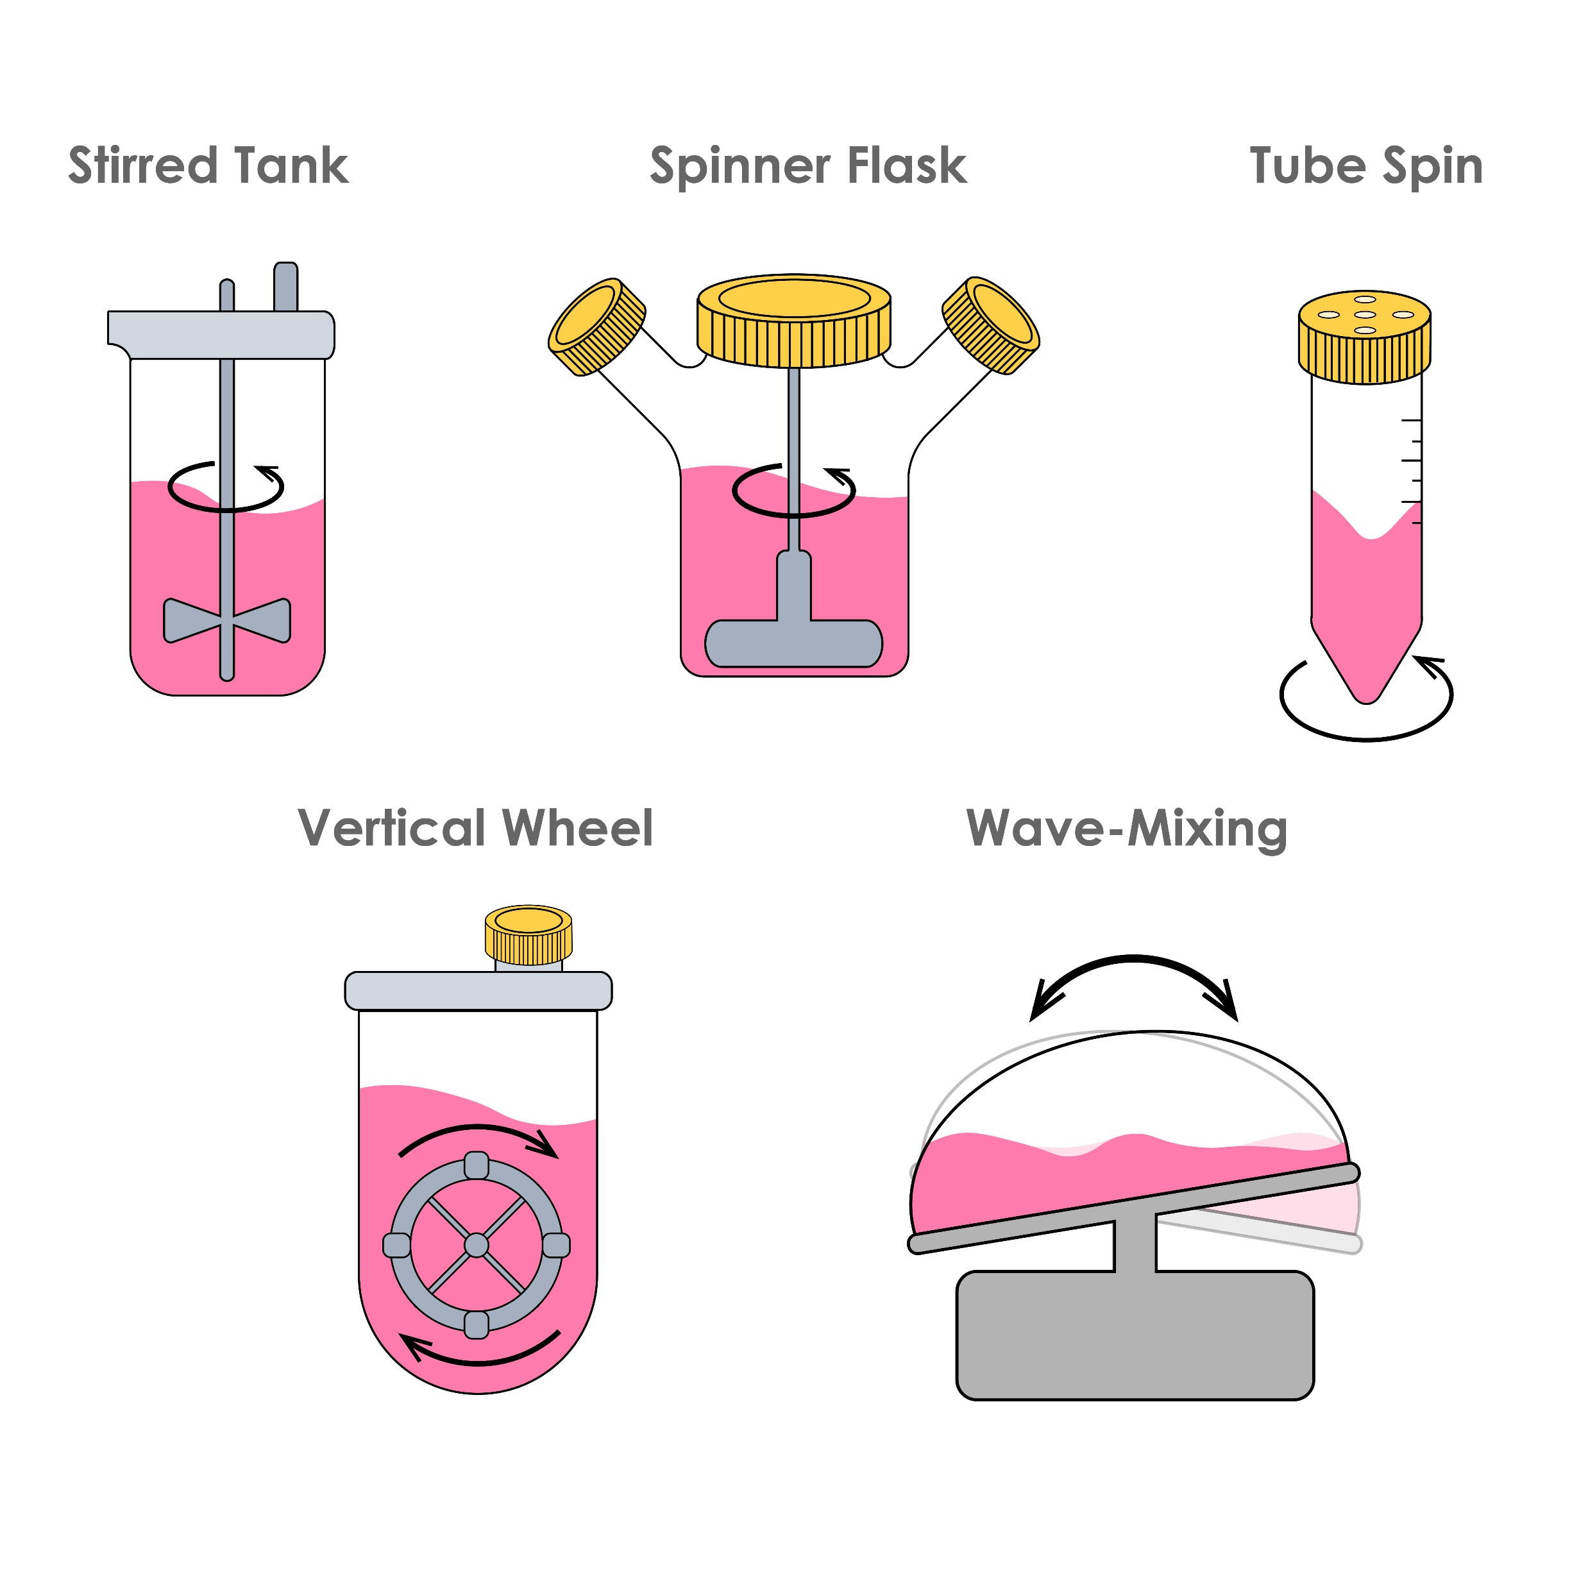
Notes:
Figure 13.5: Mixing bioreactors.

Slide 7
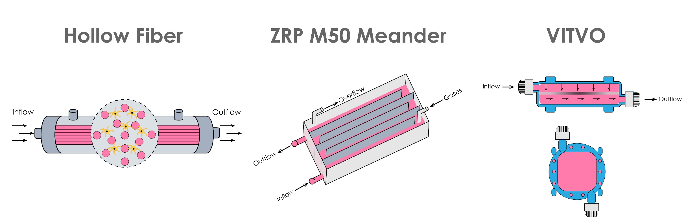
Notes:
Figure 13.6: Perfusion bioreactors.

Slide 8
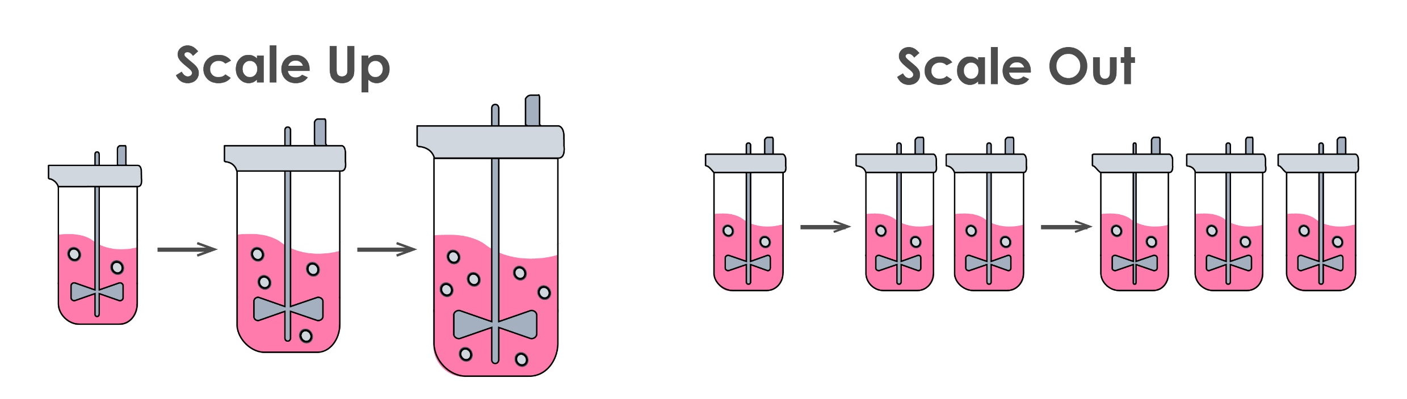
Notes:
Figure 13.7: Scale-up vs. scale-out approaches.

Slide 9
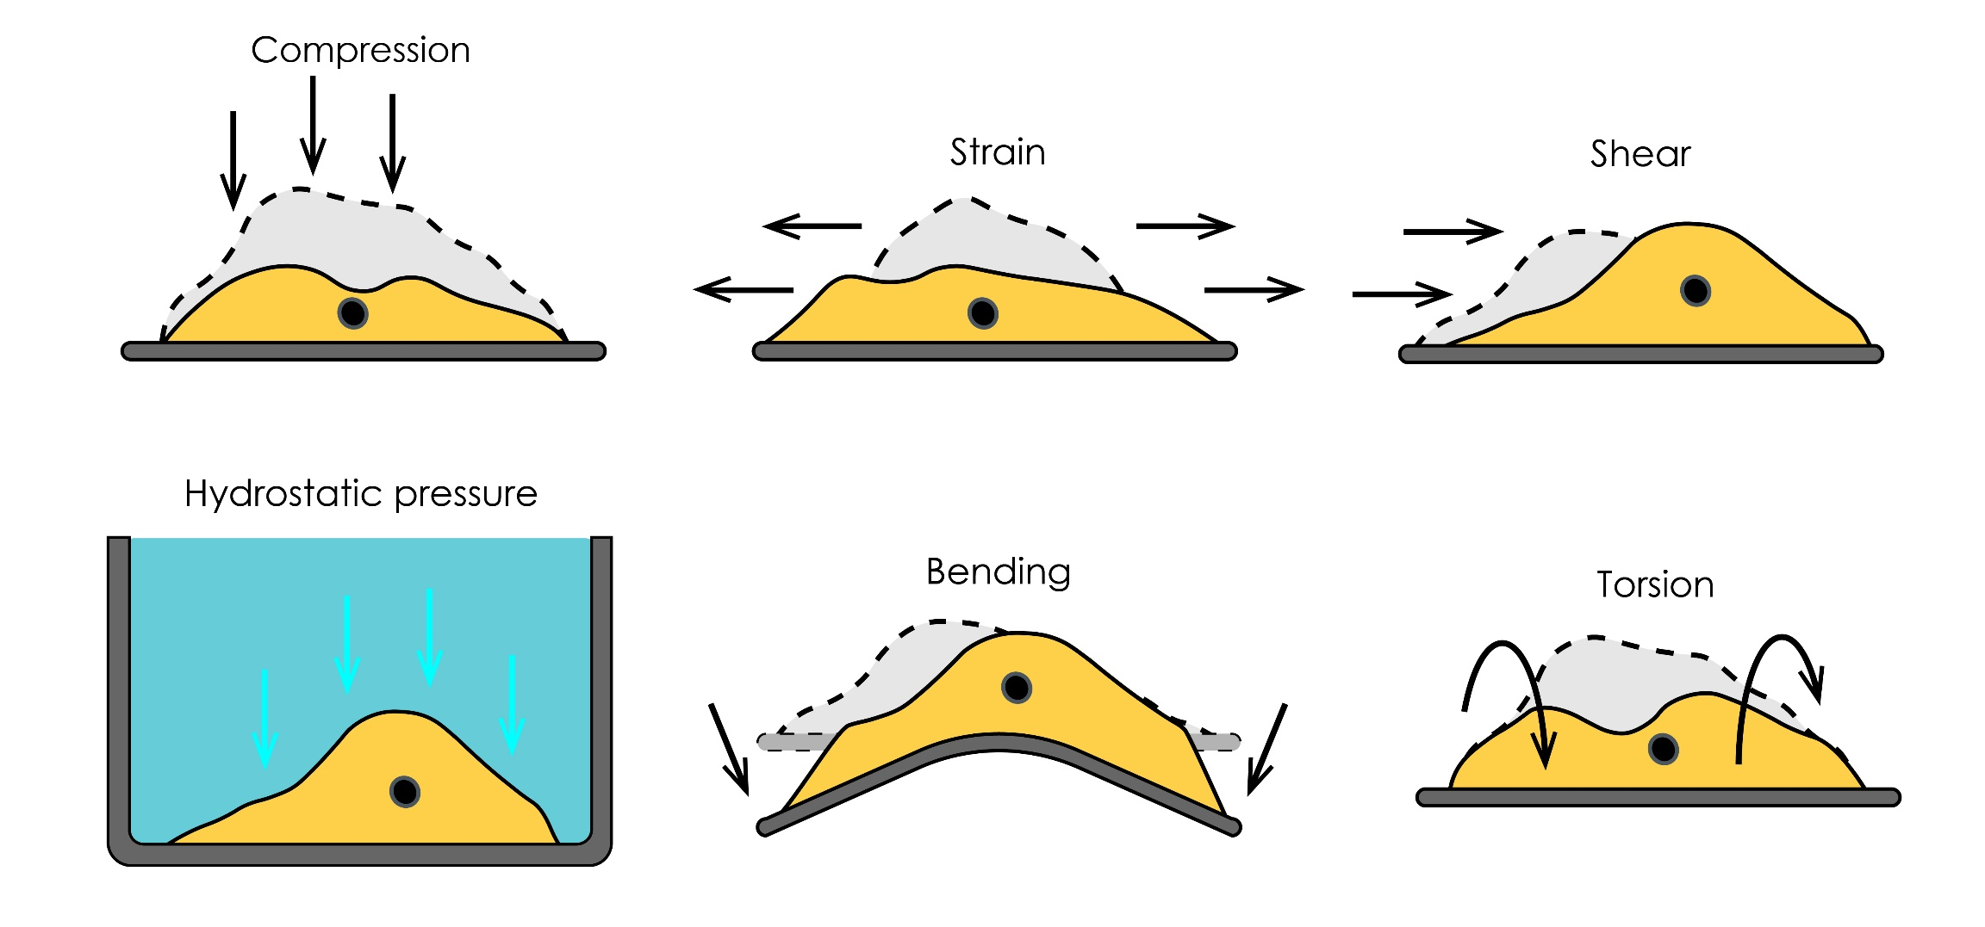
Notes:
Figure 13.8: Mechanical forces acting on cells.

Slide 10
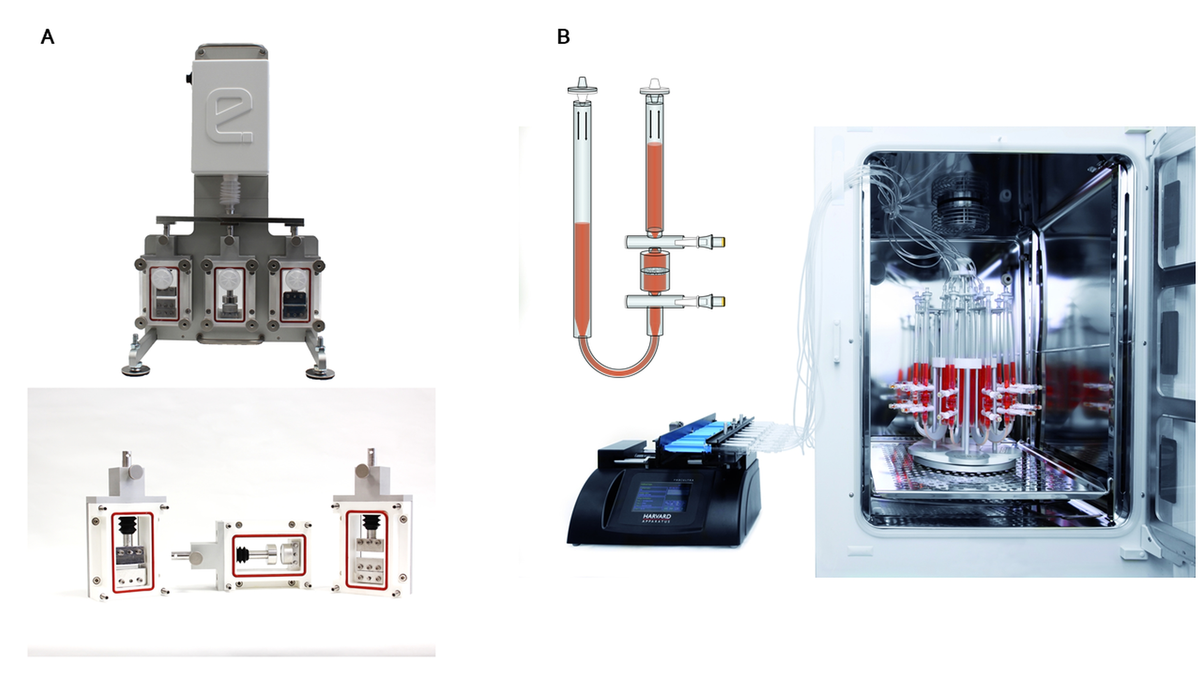
Notes:
Figure 13.9: Commercial bioreactor systems.
From Cellec Biotek AG.

Slide 11
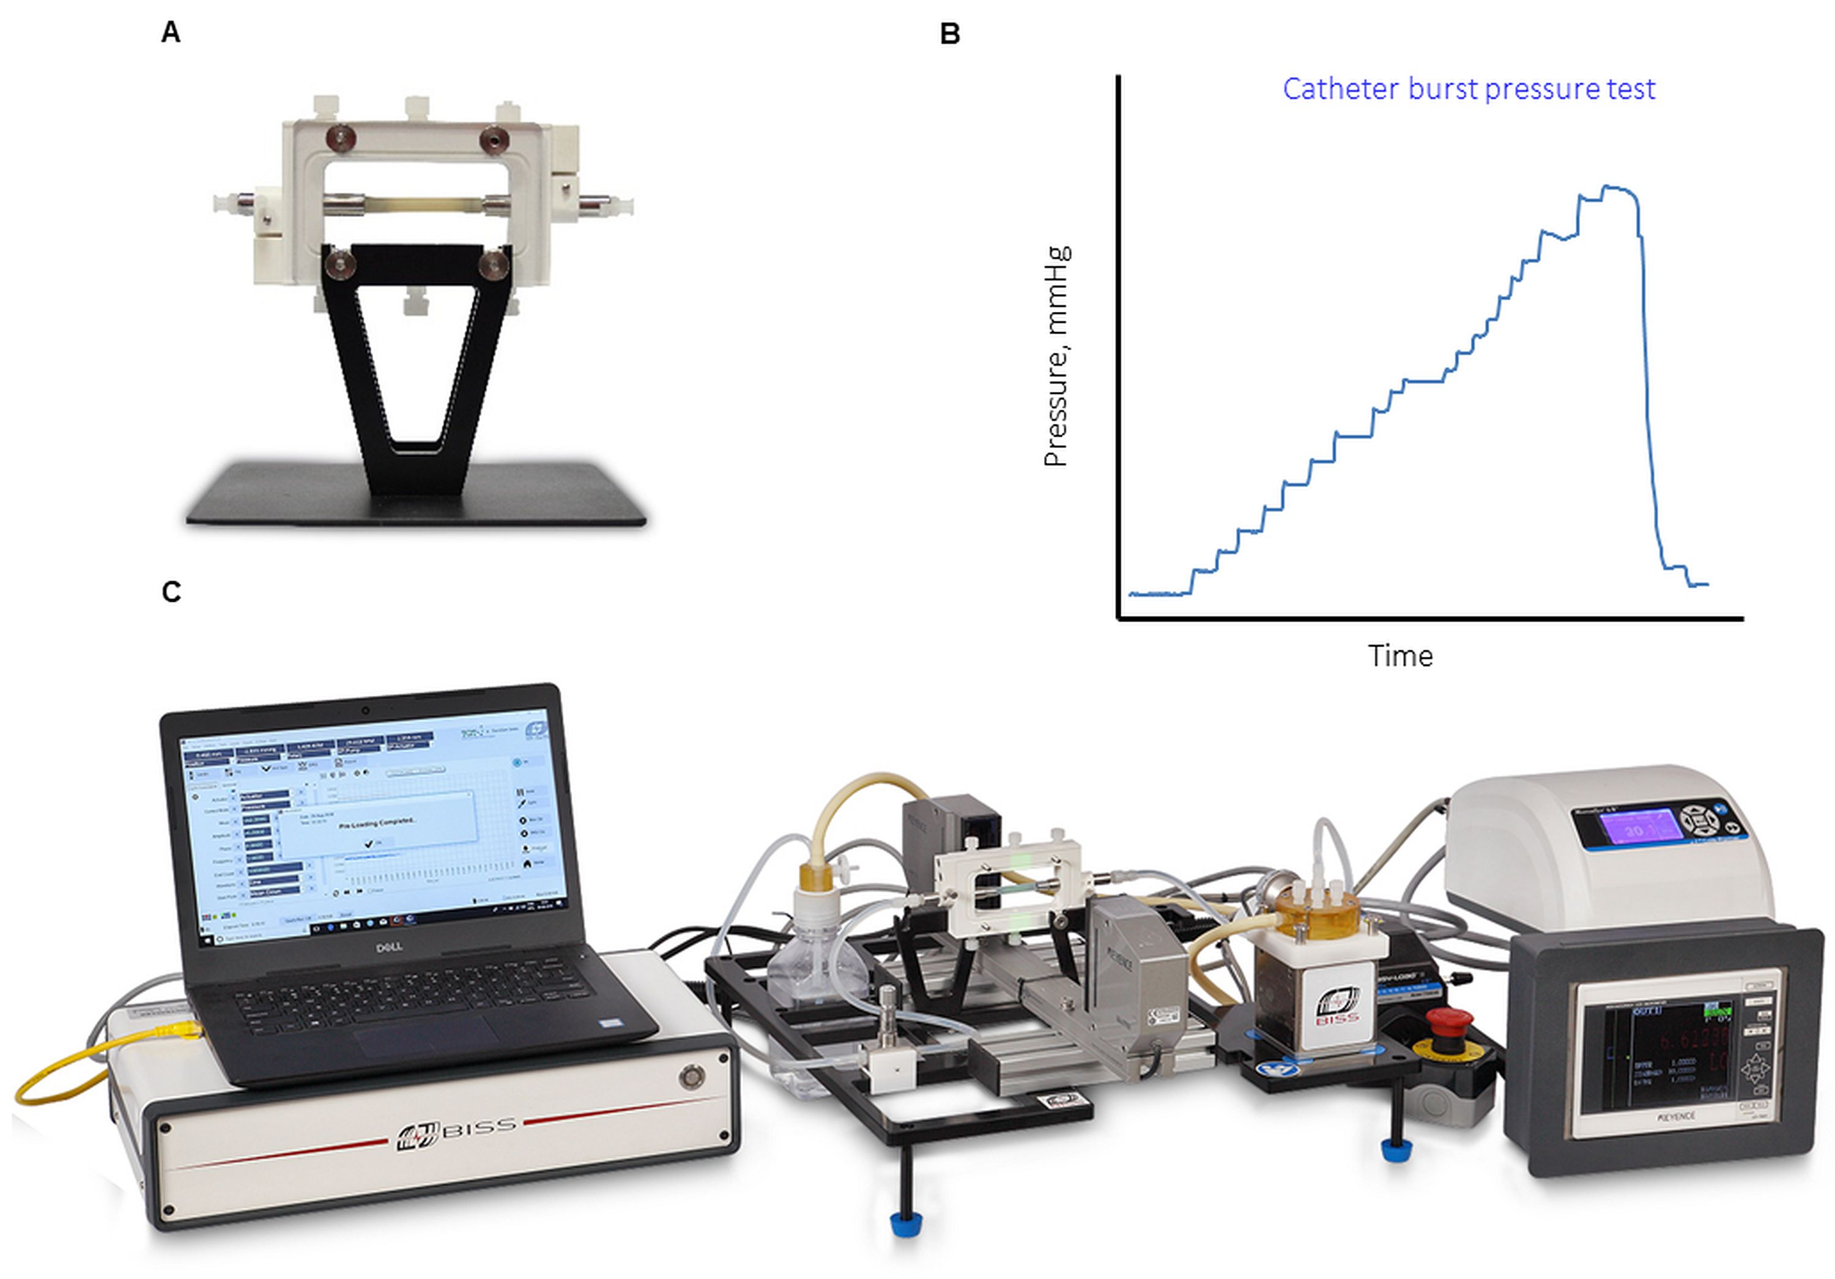
Notes:
Figure 13.10: Commercial bioreactor systems. The LumeGen Pulsatile Stimulation Bioreactor System by ITW India.

Slide 12
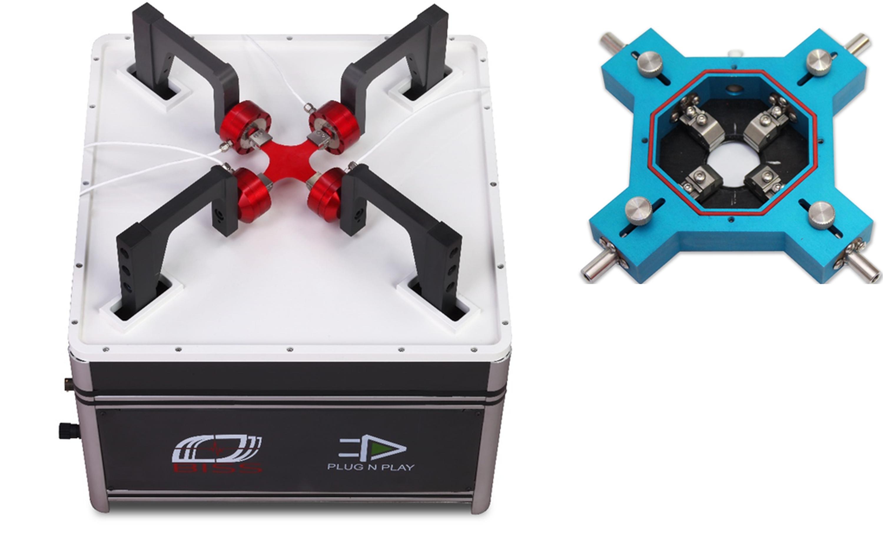
Notes:
Figure 13.11: Commercial bioreactor systems. The Planar Bioaxial Bioreactor System by ITW India.

Slide 13
Notes:
Figure 13.12: Bioreactor setup for dynamic culture of native cornea tissue.
From In Vivo‐Like Culture Conditions in a Bioreactor Facilitate Improved Tissue Quality in Corneal
Storage, Hansmann et al., 2017, Biotechnology journal.

Slide 14
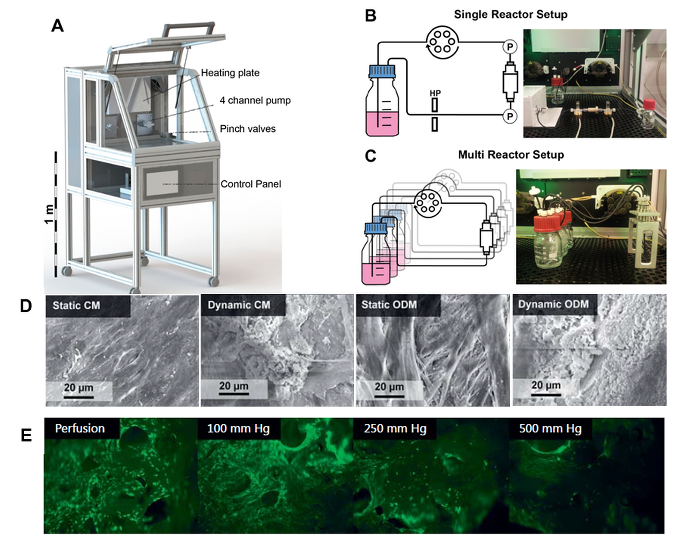
Notes:
Figure 13.13: Integrated incubator with parallelizable miniaturized perfusion bioreactor system for screening and optimization of Tissue Engineering processes.
From Application of a Parallelizable Perfusion Bioreactor for Physiologic 3D Cell Culture, Egger et al., 2017. Cells Tissues Organs, 203(5): p. 316-326.

